Slide 1
Alabama Public Safety Telecommunicator Program
Where we are now
AND
where we need to go!

Slide 2
Introduction and Contact Information
Laura Ehrhart
Education and Outreach Program Manager, Alabama 9-1-1 Board
Office: 334.440.7912
Mobile: 334.451.9984
Laura@al911board.com

Slide 3
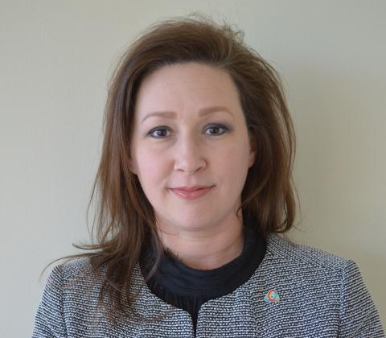
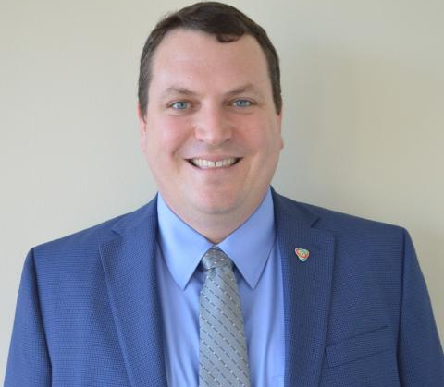
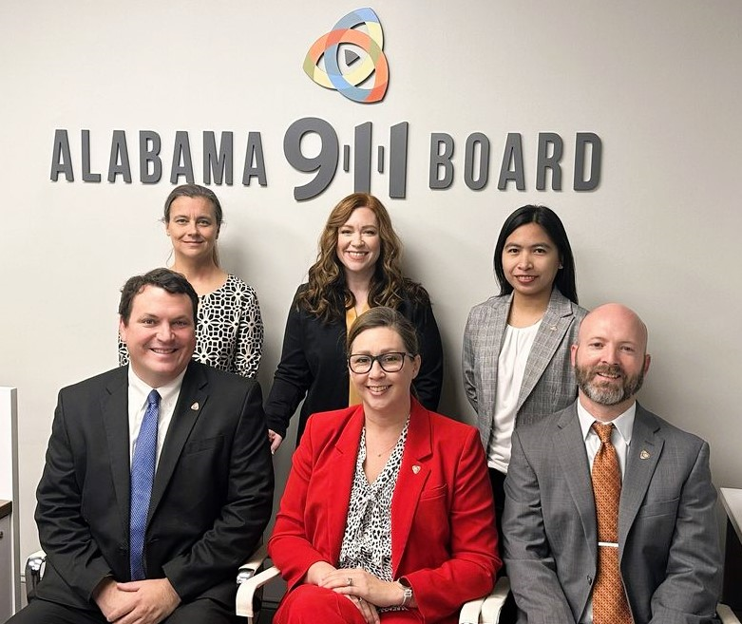
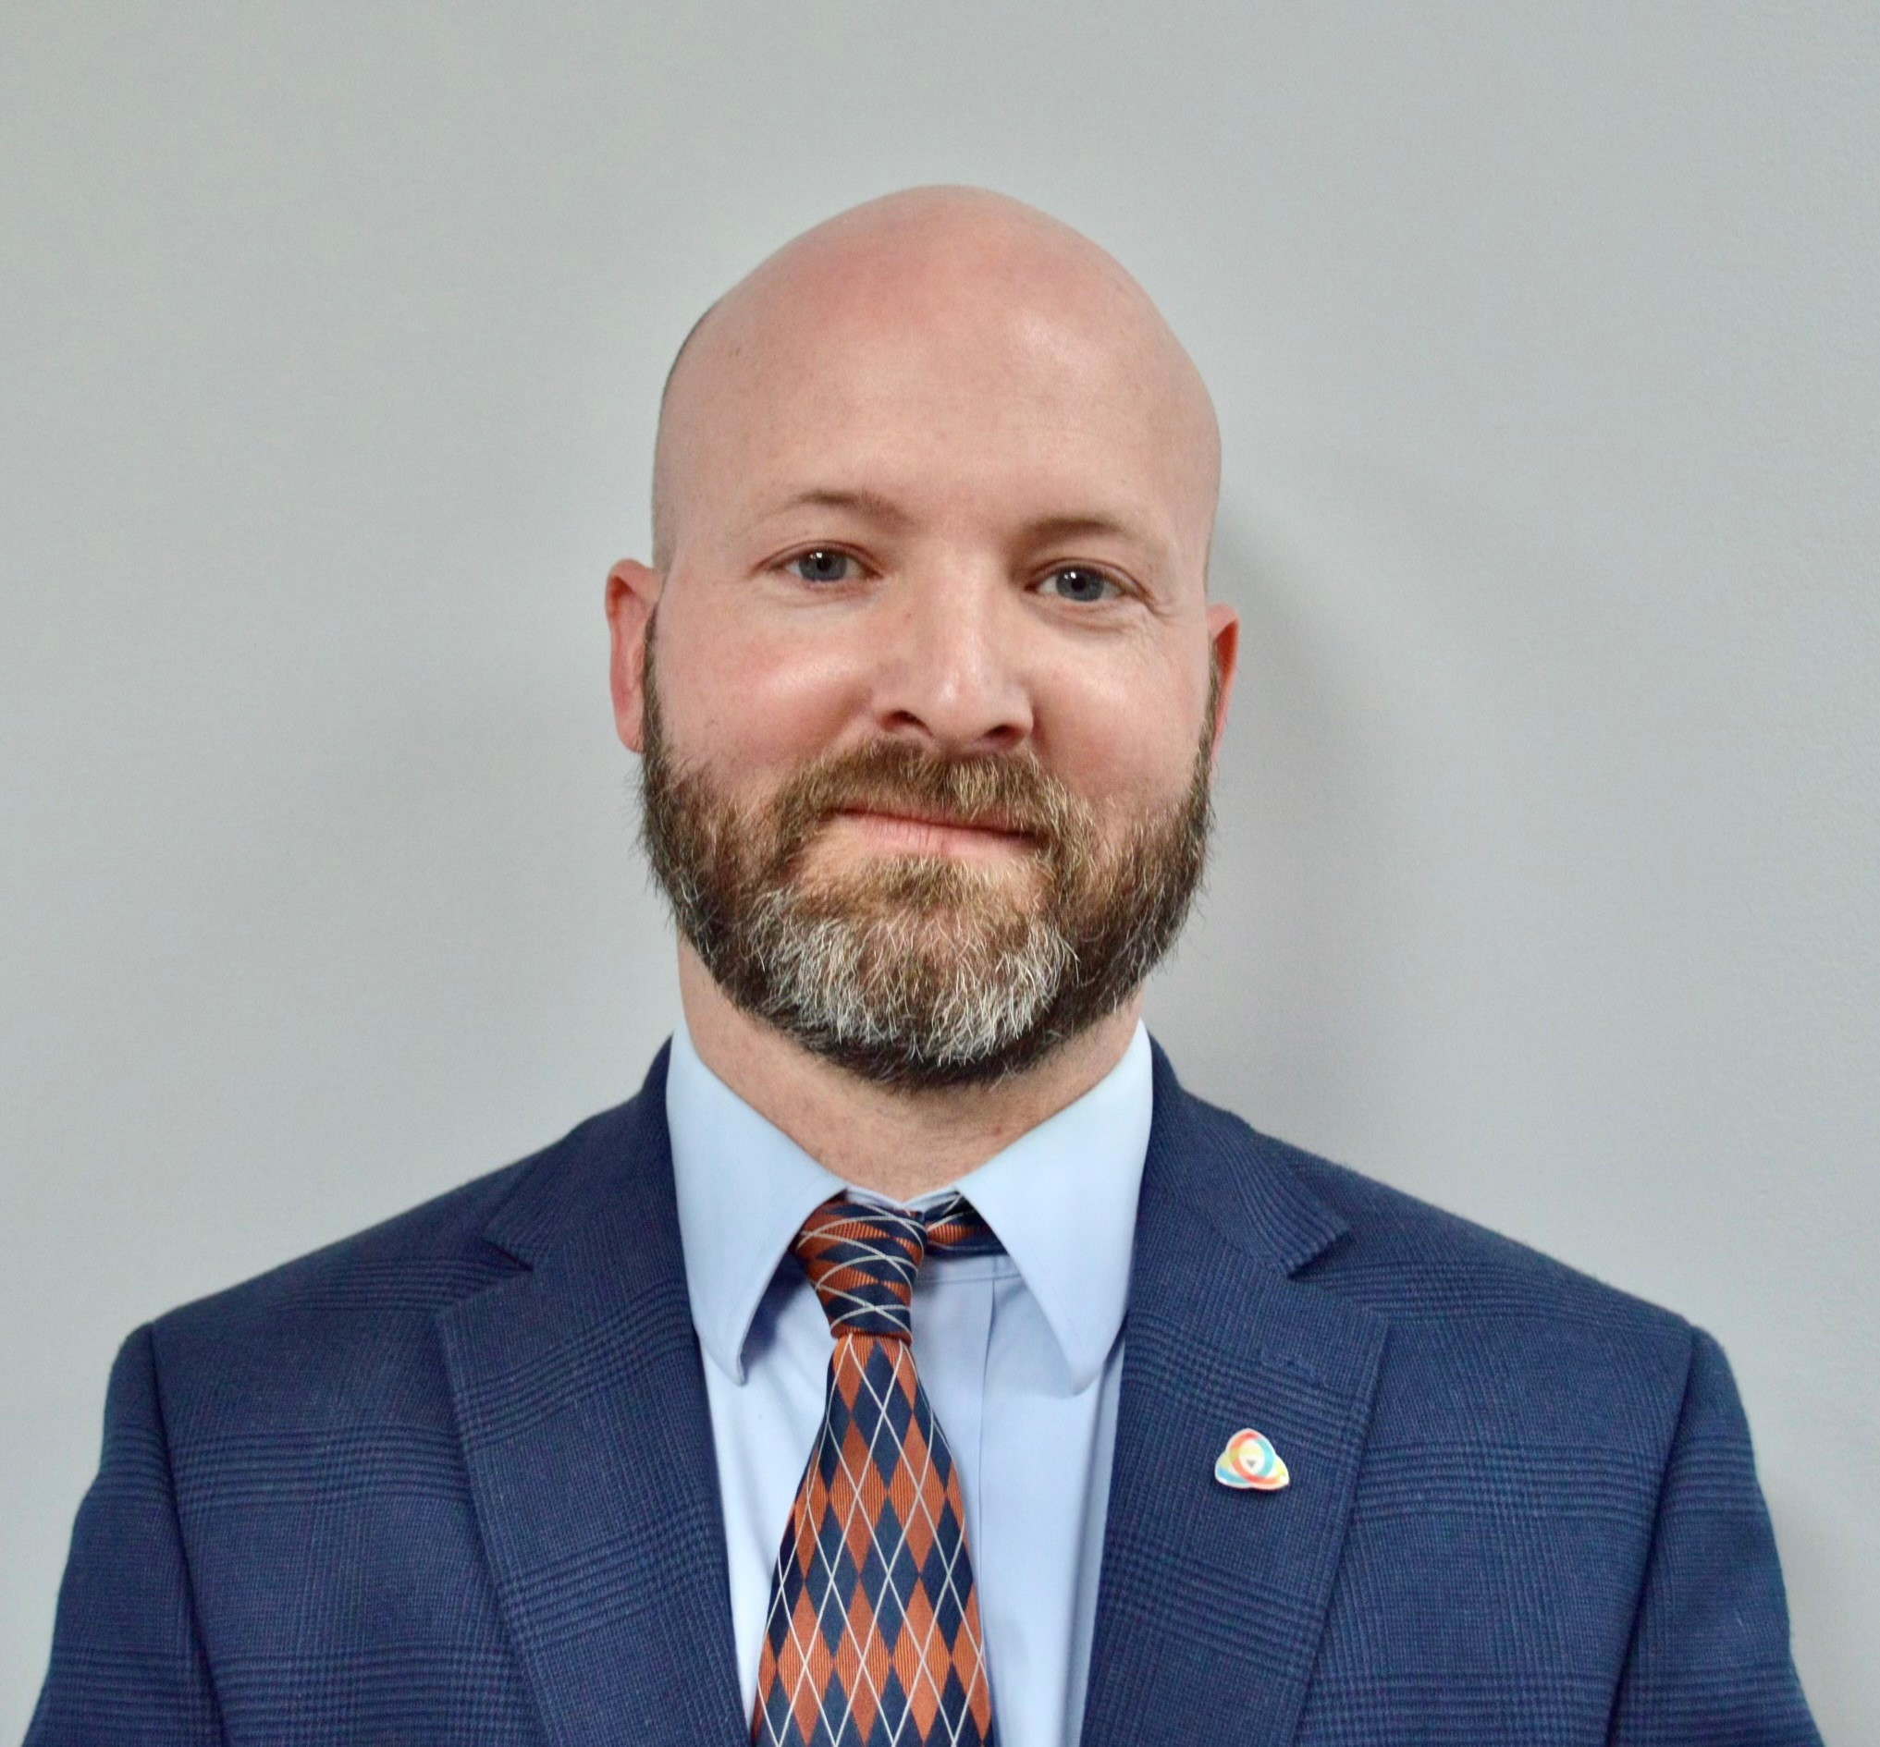
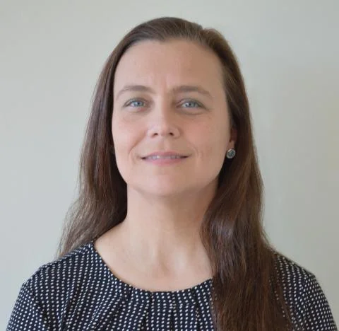
Our Team
Leah Missildine
Anderson Brooms
Executive Director
GIS Program Manager
Adam Brown
Nida Jackson
Deputy Director
Deputy Director
Michelle Peel
Senior GIS Specialist
Program Coordinator

Slide 4
Public Safety Telecommunicator
Certification Status
Today’s
TOPICS
PST Certification Maintenance Phase
Alabama EMD
Wholesale Review

Slide 5
The 4 W’s of the PST Certification Program
W
W
W
W
can I get more information
WHAT is it?
WHERE
WHY was it created ?
WHO is affected ?
?
A new state mandate that requires all PSTs to undergo standardized training, accompanied with a yearly requirement of at least 12 hours of CEUs to maintain certification.
To ensure that every PST meets the established training standards to enhance their competence and effectiveness.
Every ECD, PSAP, PST, first responder, and any person who
calls 9-1-1.
Alabama 9-1-1 Board Website
www.al911board.com

Slide 6
Big Mac®
Two 100% beef patties, a slice of cheese, lettuce, onion and pickles. And the sauce. That unbeatable, tasty Big Mac® sauce. You know you want to.

Slide 8
Without standards, there can be no improvement.
-Taiichi Ohno

Slide 9
The 5 Main Components
Public Safety Telecommunicator
MASTER LIST
Data collection is imperative to maintain accurate records. Until June 2022, the 9-1-1 Board did not have a comprehensive list of Alabama’s PSTs.
Every PST employed by a primary PSAP must be enrolled in Virtual Academy, the platform through which certifications will be issued and tracked, including CEUs and renewals.
Anytime a new PST is hired, a current PST leaves the agency (or needs to report a name change, email change, or change of agency), OR earns a certification, a PST Certification Status Form needs to be submitted.

Slide 10
The 5 Main Components
Public Safety Telecommunicator
MASTER LIST
All new PSTs are required to be enrolled in a 40-hour, Board-approved PST course within 180 days of their hire date. They must complete certification within 180 days of beginning coursework.
There is a list of approved courses under the Frequently Asked Questions tab on the Certification and Training page.
The Alabama 9-1-1 Board will reimburse the agency for the cost of the course and its materials.
40-Hour PST
Board-Approved Course

Slide 11
The 5 Main Components
Public Safety Telecommunicator
MASTER LIST
All PSTs hired prior to July 1, 2022, are eligible for a 100-question competency exam to deem them certified {if they don't hold a current PST certification}.
The Competency Exam is a 100 question, proctored, and timed exam, created to evaluate competency for those who already have PST experience. The PST must pass with a 70% or higher grade and is allowed a total of 3 chances to pass the test.
Our website provides a list of Virtual Academy Roll Call clips to view for test preparation.
40-Hour PST
Board-Approved Course
Competency Exam

Slide 12
The 5 Main Components
Public Safety Telecommunicator
MASTER LIST
40-Hour PST
Board-Approved Course
All PSTs who have met or exceeded the minimum training and performance requirements as defined by the PST Certification mandate, will receive the Reciprocity Acknowledgement Course in Virtual Academy.
This 4-question acknowledgement questionnaire is representative of a 40-hour approved PST course.
Competency Exam
Reciprocity Acknowledgement

Slide 13
The 5 Main Components
Public Safety Telecommunicator
MASTER LIST
40-Hour PST
Board-Approved Course
12 hours can be obtained throughout the year by taking online courses, in person classes, attending conferences, in-house training, staff meetings, etc.
We provide a recommended list of CEUs on our website.
The Alabama 9-1-1 Board also hosts various classes and advertises other available classes on our website Certification and Training | Alabama 911 Board (al911board.com).
* We are actively seeking feedback regarding in-person classes to offer Alabama’s PSTs *
Competency Exam
Reciprocity Acknowledgement
12 Continuing Education Units Annually

Slide 14
PST Certification Program Timeline
June 2022
October
2022
January 3, 2023
April 14, 2022
October 2023
House Bill 414 was signed into a law as Act 2022-387 by Governor Ivey
The Alabama 9-1-1 Board began collecting data from the ECDs and PSAPS on current PSTs
The PST Certification Program officially launched as the
first mandated
training program
for Alabama PSTs
93% of
Alabama’s
1902 PSTs
are certified.
The PST Certification Rule
officially
went into effect
At this time there was
no master
PST list

Slide 15
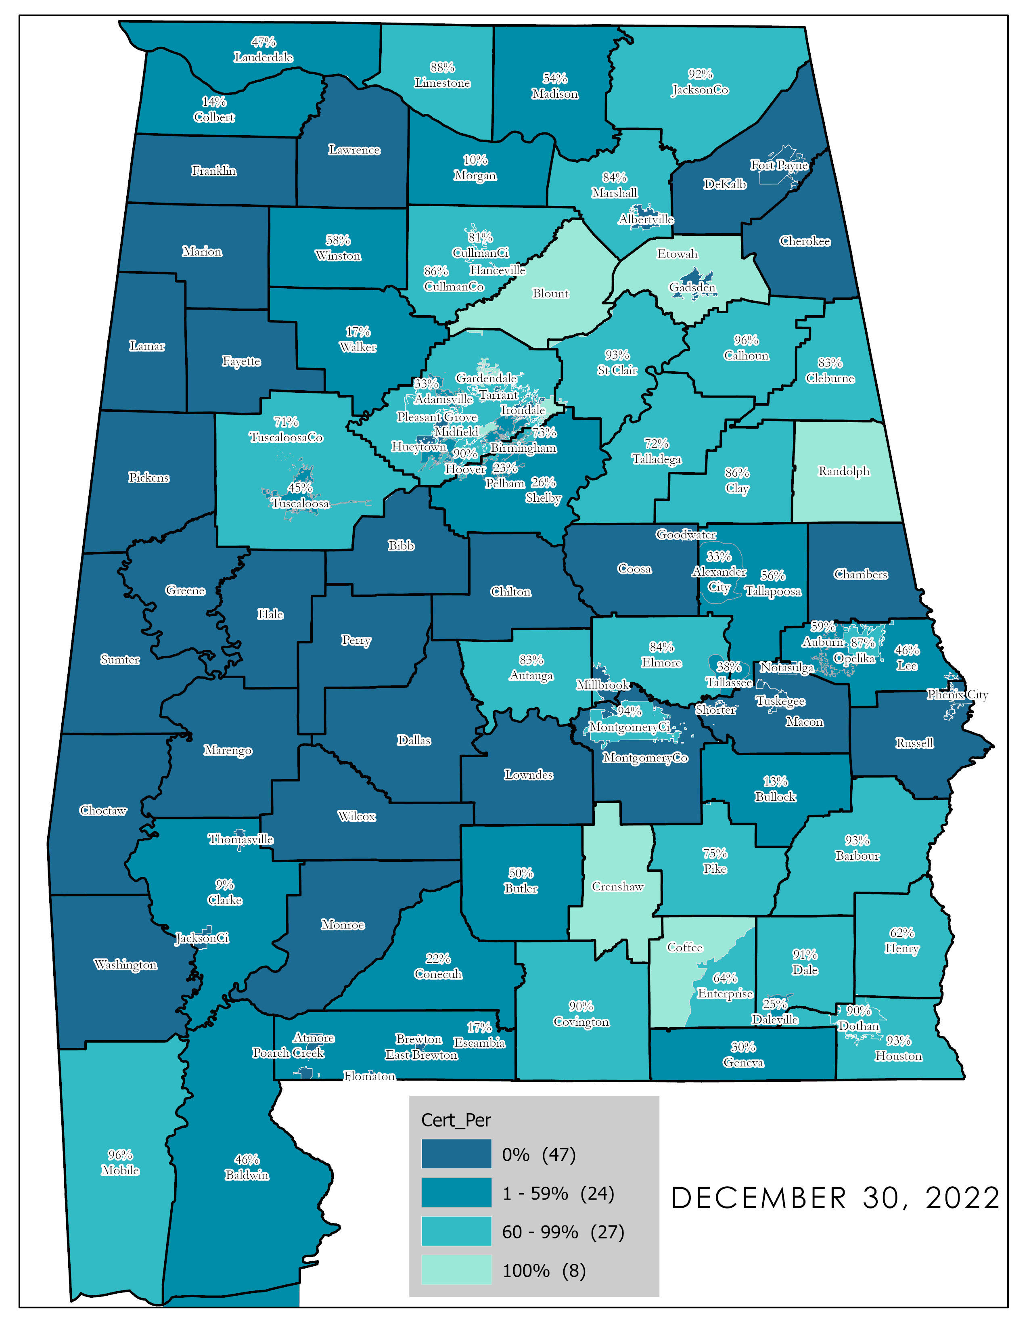
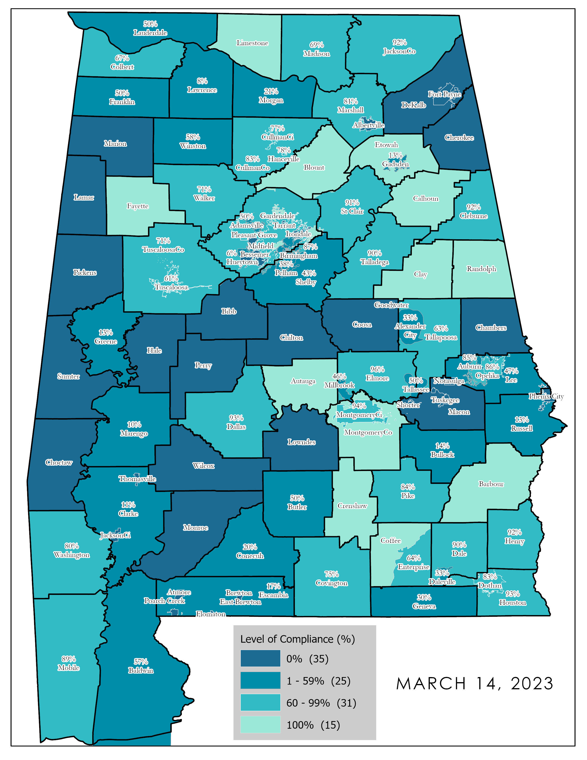
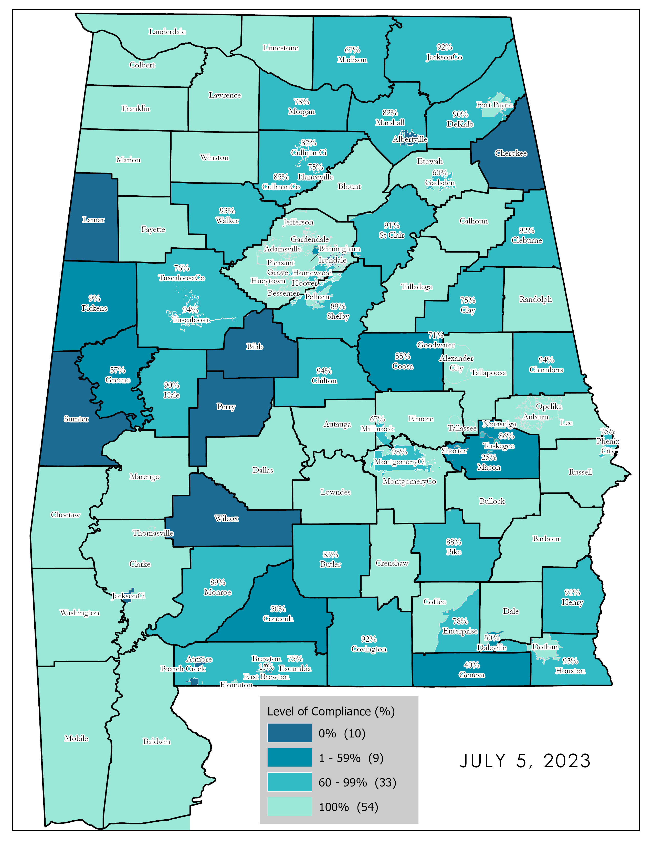
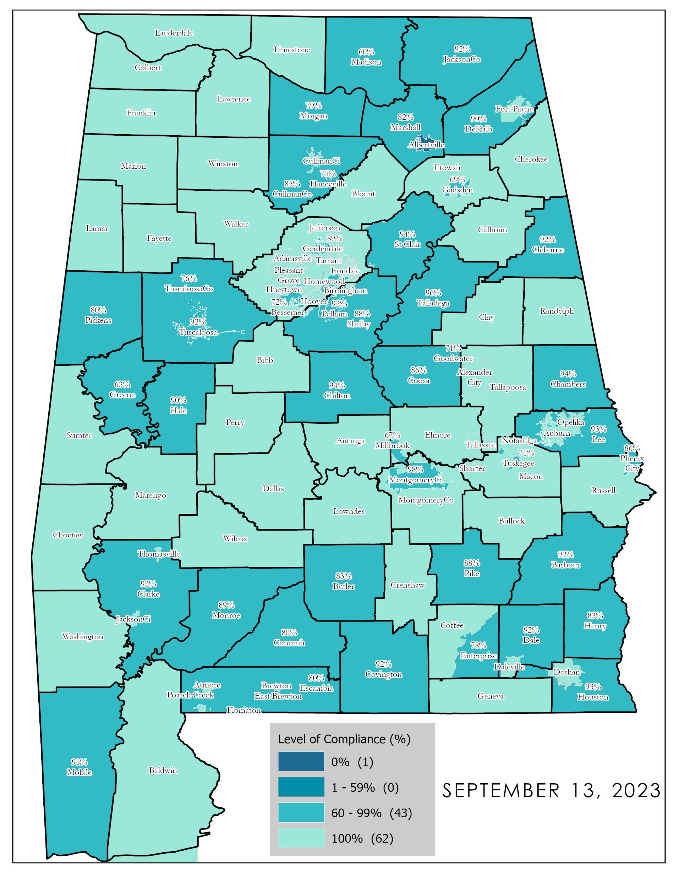
10 Month Progression
December 2022 September 2023

Slide 16
1902 PSTs currently on the Master List
92% are Certified PSTs OR enrolled in a PST course
93%
82%
57%
49%
December 2022
March 2023
July 2023
October 2023
87% Increase in PST Certification status

Slide 17
What are the monetary penalties if an ECD is not compliant?
Non-compliance Timeframes following notifications
Ala. Admin. Code r. 585-X-5-.02
Penalties shall be imposed for Districts that are noncompliant and notice of noncompliance shall be provided to the District by the Board. Upon notice of noncompliance, the following timeframes shall begin.
100%
12 months of noncompliance
75%
9 months of noncompliance
50%
6 months of noncompliance
25%
3 months of noncompliance
District withholdings due to noncompliance will be held in escrow until the District becomes compliant. When a District becomes compliant, the monthly distribution will be restored along with any withheld funds on the Board's next monthly distribution

Slide 18
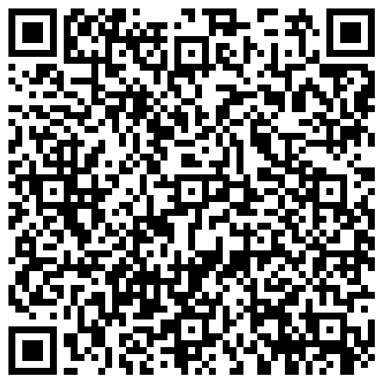
SCAN the QR code for the
PST Certification Program page
on the Alabama 9-1-1 Board Website
Links to all Forms that should be submitted:
PST Certification Status Update
Certification Course Request for Payment
Intent to Test
PST Certification FAQ
List of Recommended CEUs
Virtual Academy Roll Calls for exam preparation

Slide 19
Consistent data collection
PST Certification Status Forms
01
HOW
do we maintain?
Virtual Academy
Adding new PSTs when hired
Moving to unaffiliated when they leave the agency
02
40-hour PST course
Enrolling within 180 days
Completing course within 180 days of enrollment
03
Continuing Education Units (CEUs)
Earning 12 hours annually (in-person or virtual)
04

Slide 20
There
Is
a
FORM
for
that!
Consistent
Data Collection

Slide 21
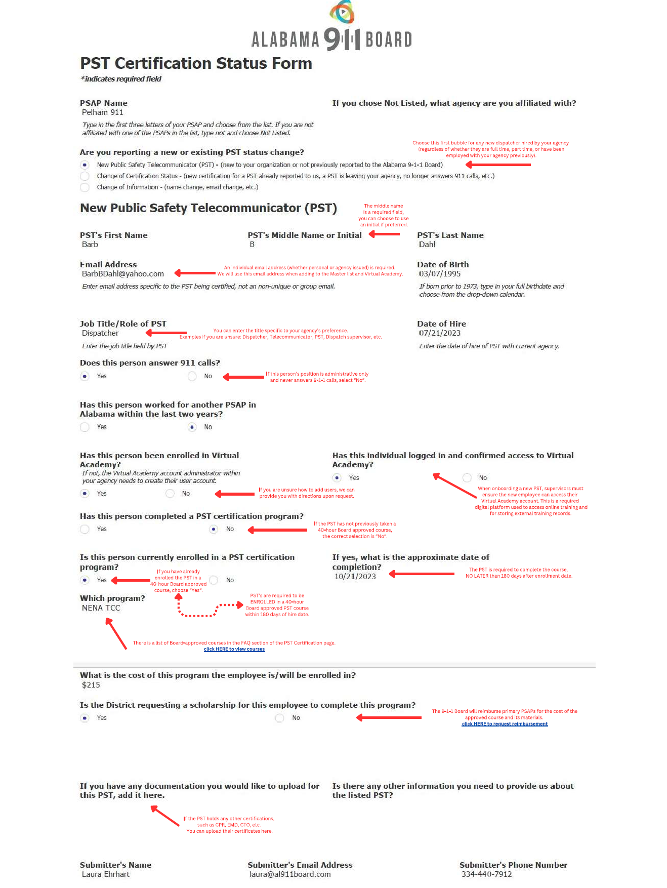
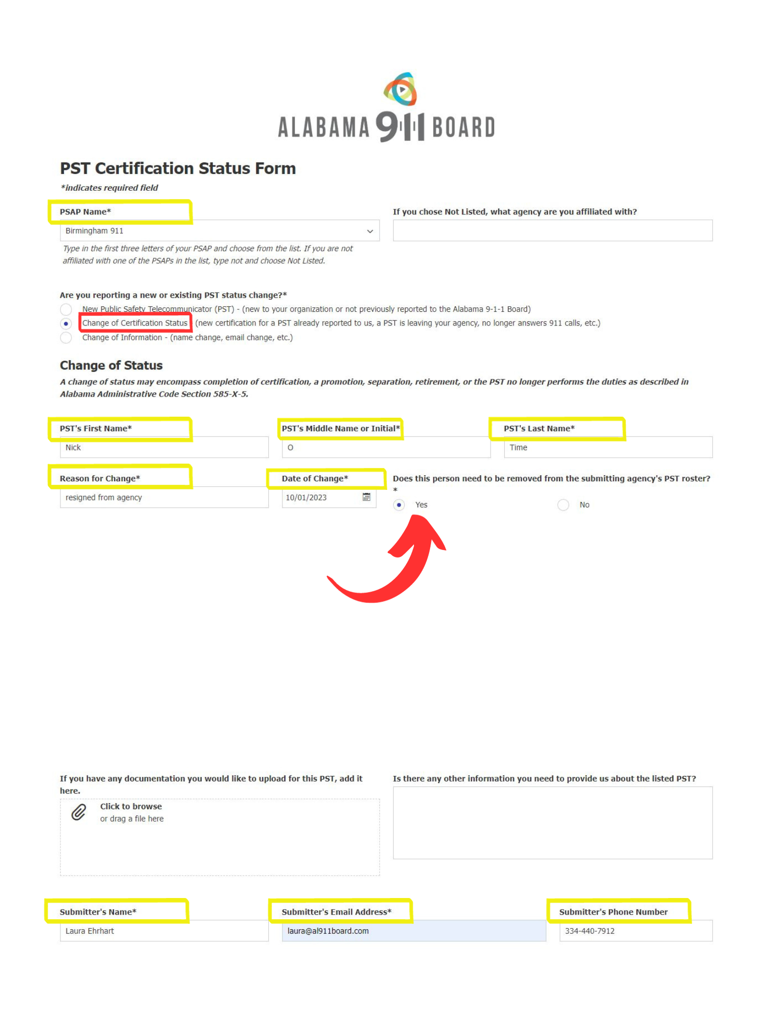
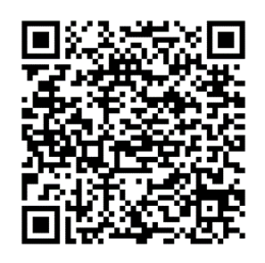
PST leaves
the agency
New PST hired

Slide 22
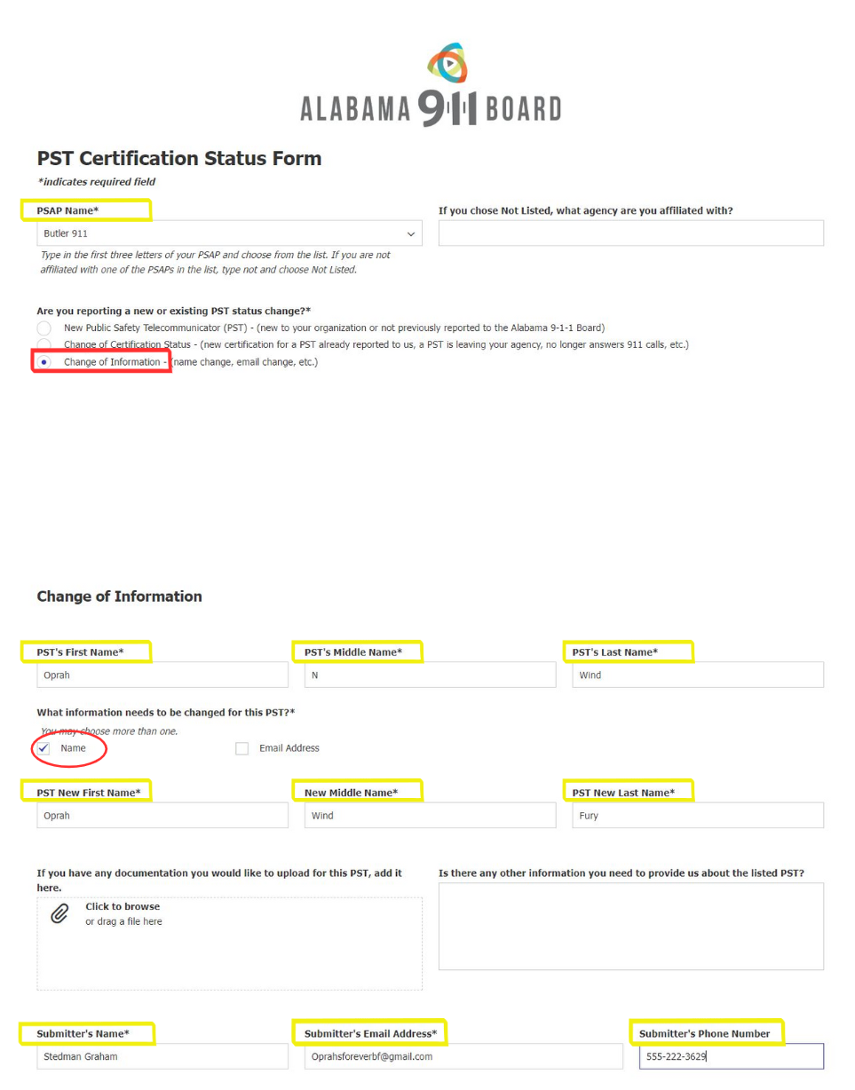
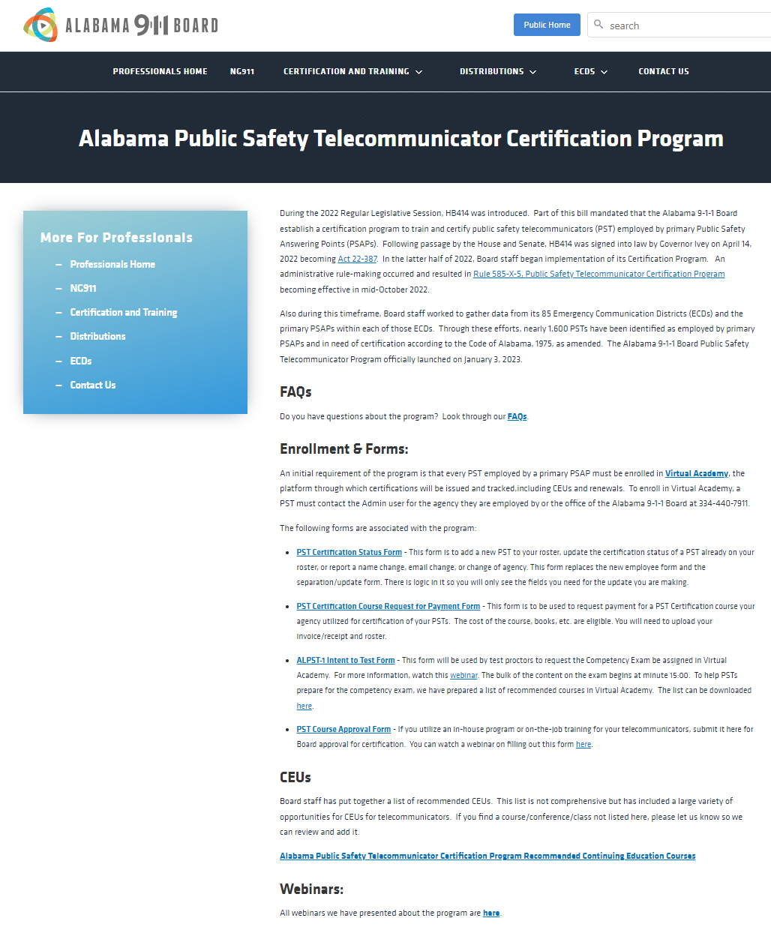
PST has a name or email change
ALL forms can be found on our website

Slide 23
Virtual Academy
Add new PSTs to your agency’s account
when hired
Take online courses
Upload external training
Move the PST to unaffiliated account upon leaving agency

Slide 24
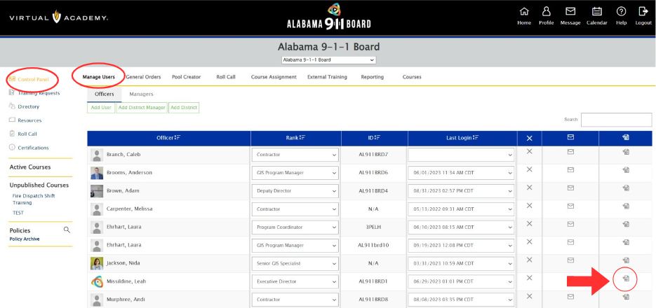
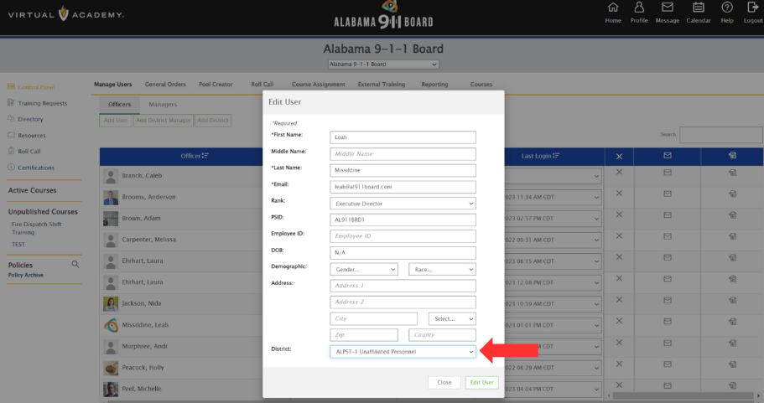
When a PST leaves your agency, they do not need to be deleted from Virtual Academy,
only moved to the unaffiliated account
Move PSTs from your Virtual Academy to an unaffiliated account

Slide 25
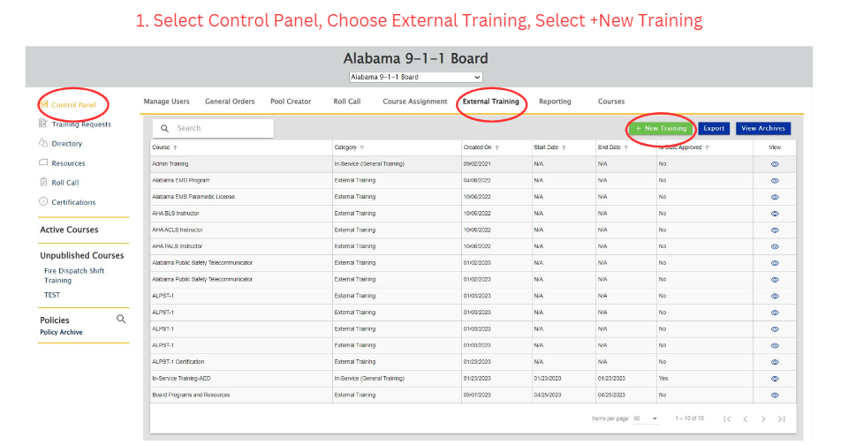
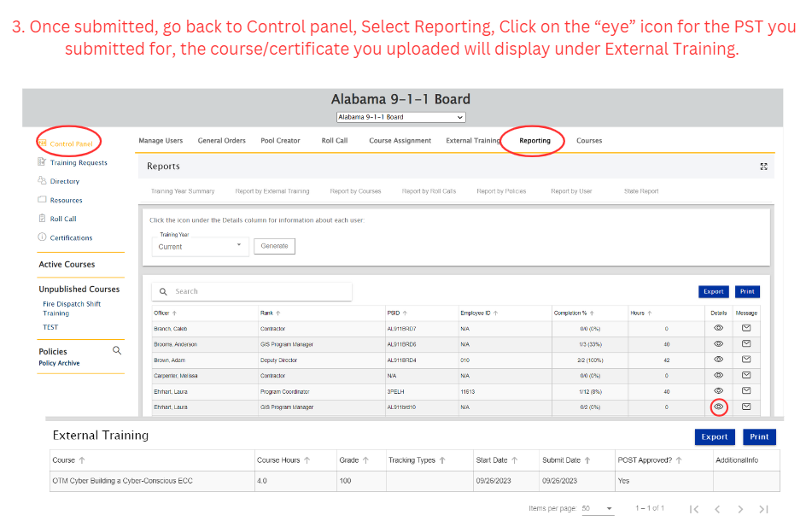
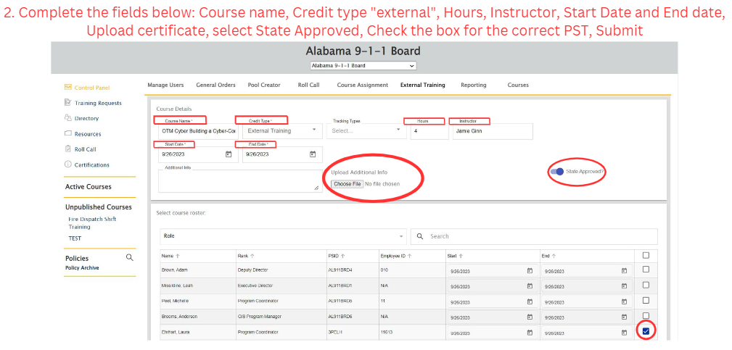
Upload External Training
External training opportunities:
Conferences
Classes/Courses (in-person or virtual)
Staff meetings

Slide 26
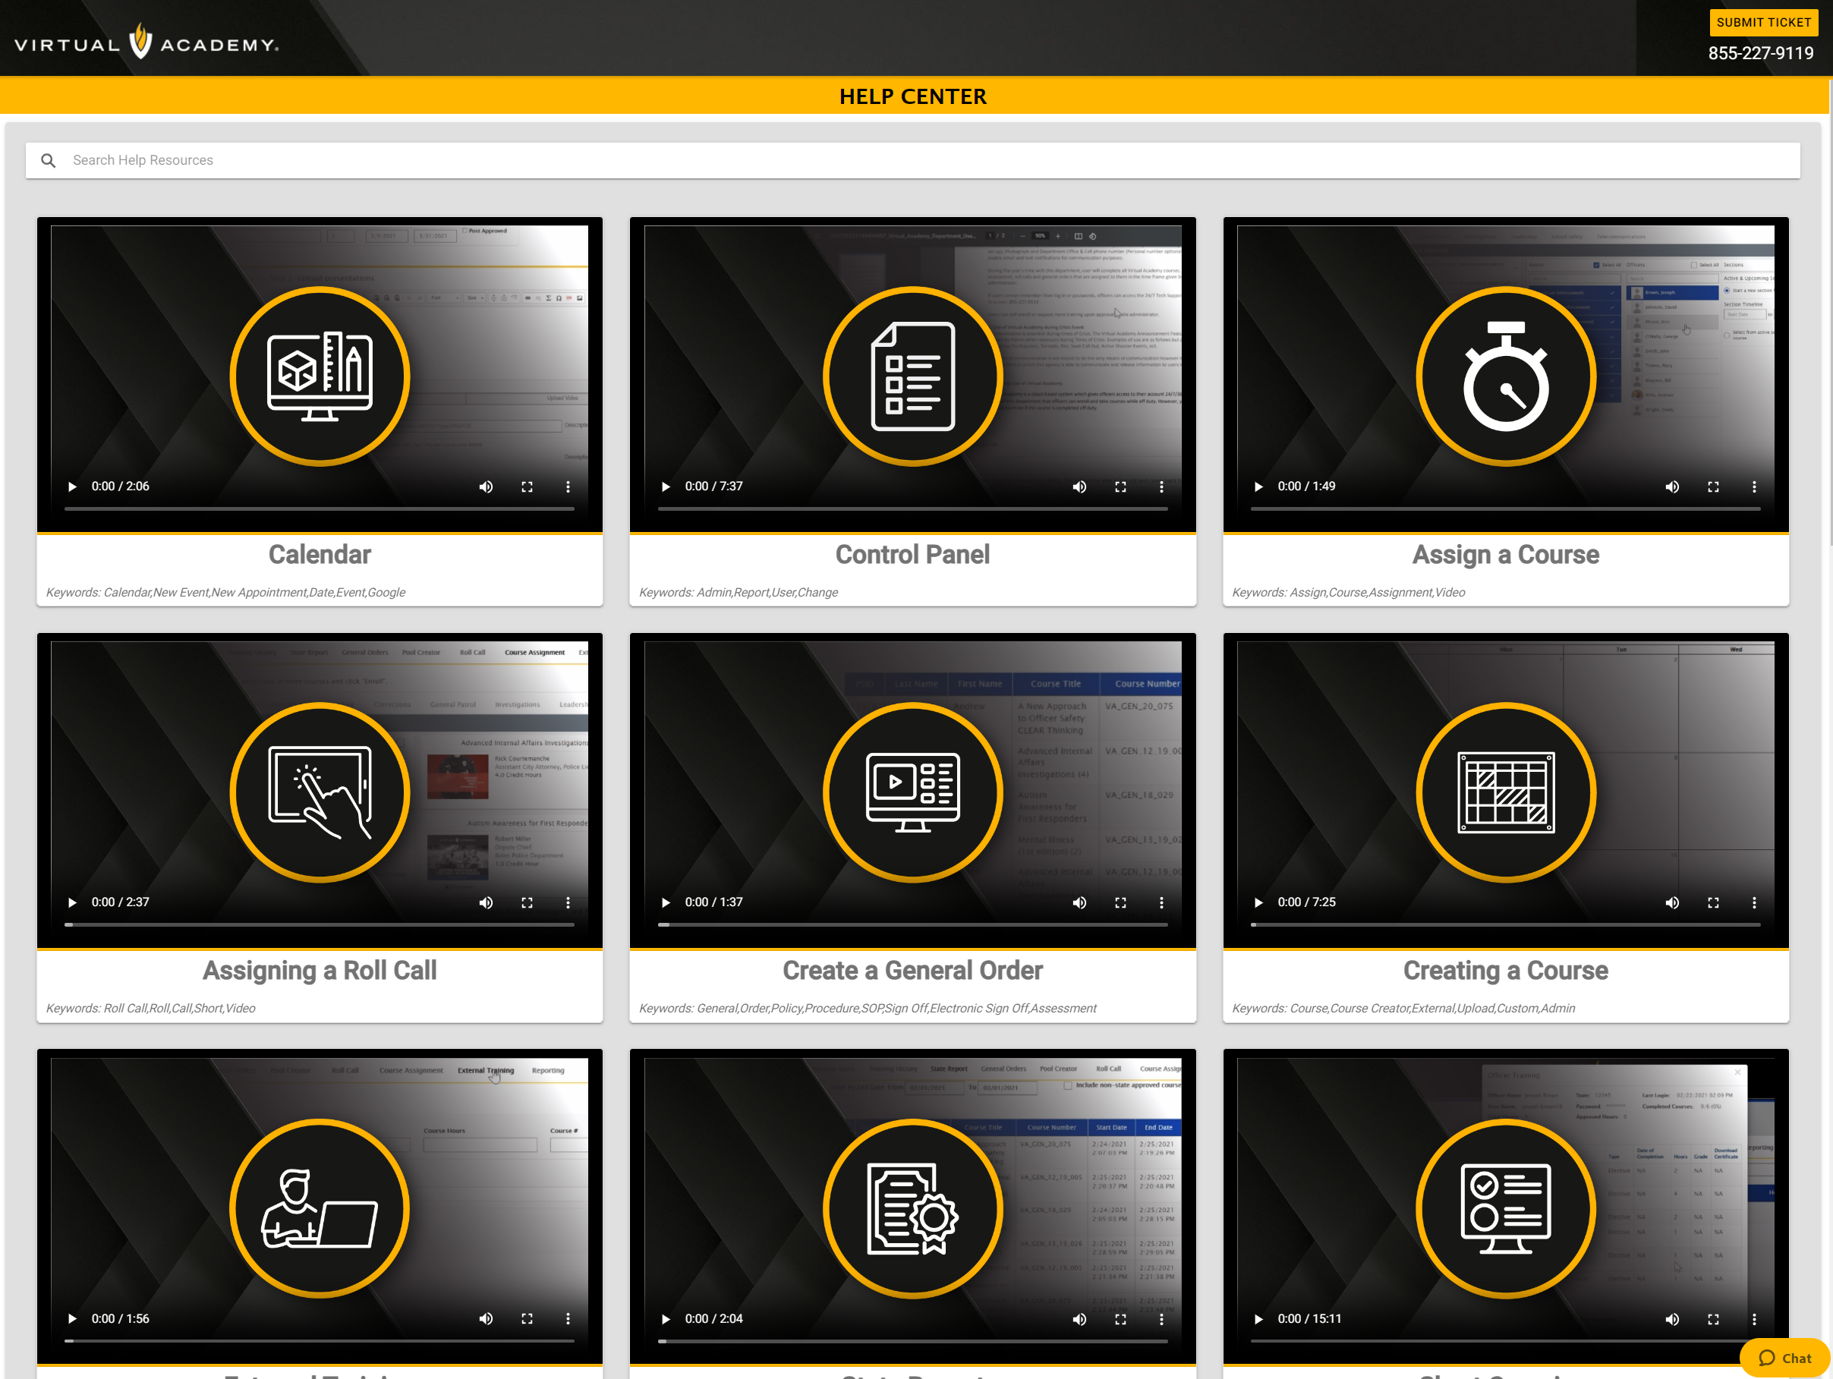
Notes:
.

Slide 27
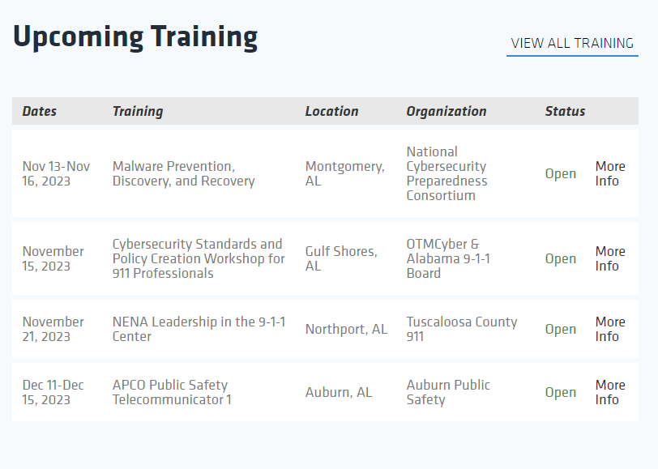
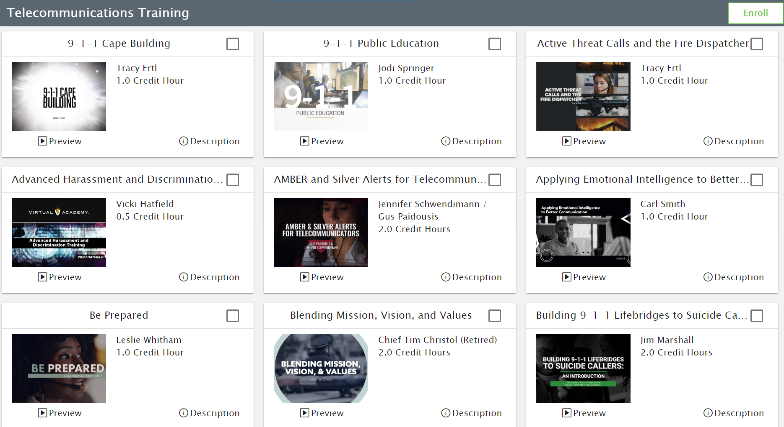
Continuing Education Units
12
To maintain the PST Certification, PSTs must obtain 12 hours of continuing education
annually. The CEU requirement begins the first full month after certification is obtained.

Slide 28
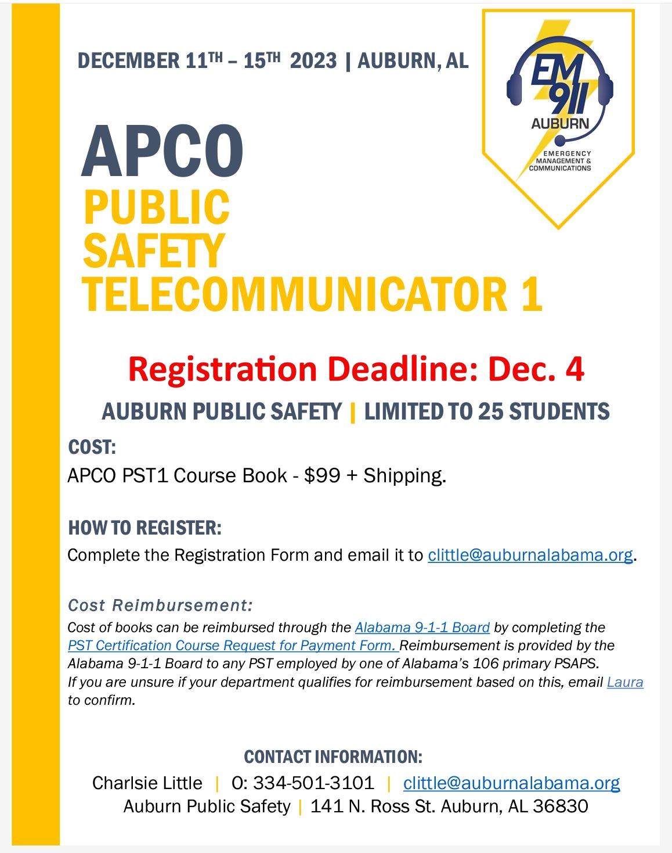

Slide 29
40- Hour
Board-approved
PST course
All Public Safety Telecommunicators must be enrolled in a 40-Hour
Board approved PST course
within 180 days of hire date.
Completion is required
within 180 days of enrollment.

Slide 30
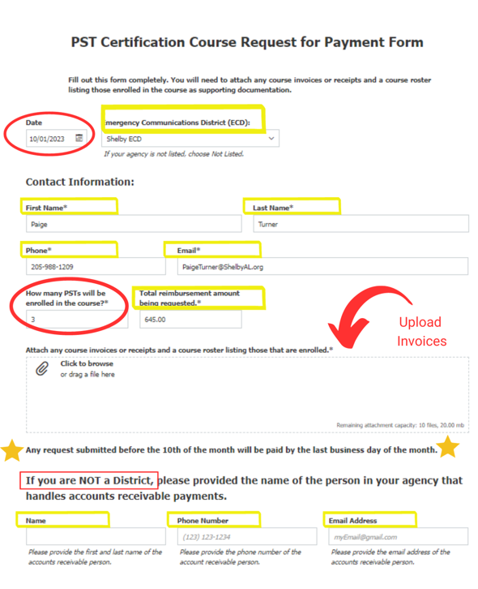
Want to be
reimbursed for the cost of the course?
There’s a form for that!!!
Primary PSAPS are eligible to be reimbursed by the Alabama 9-1-1 Board for all Board-approved 40-hour PST courses, in addition to recertification fees if applicable.

Slide 31
Guidebook
Alabama EMD
Wholesale
Review
Policy
Training
Material

Slide 32
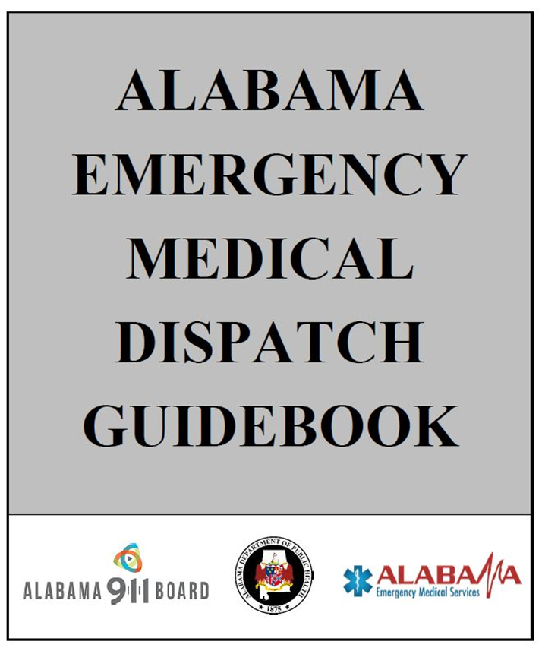
Ease of Use
Guidebook
Enhance the labeling, possibly color coding
Layout: Flip Book Vs. Spiral Bound Style
Moving childbirth directions to the pregnancy/childbirth tab
Guide Card Natures
Separating Gunshot/Stabbing or add Penetrating Trauma card
Add Suicide by Hanging, Broken bone, Altered mental status and Sexual Assault cards
More clear directions for Diabetic and Allergic reaction cards
Questions Specific to Nature
Additional information or instructions for EPI pen
More detailed questions to determine Agonal breathing to begin CPR quicker
More explicit directions about giving sugar to diabetic patients
Digital Version Update
More user-friendly digital option
Consideration for CAD integration

Slide 33
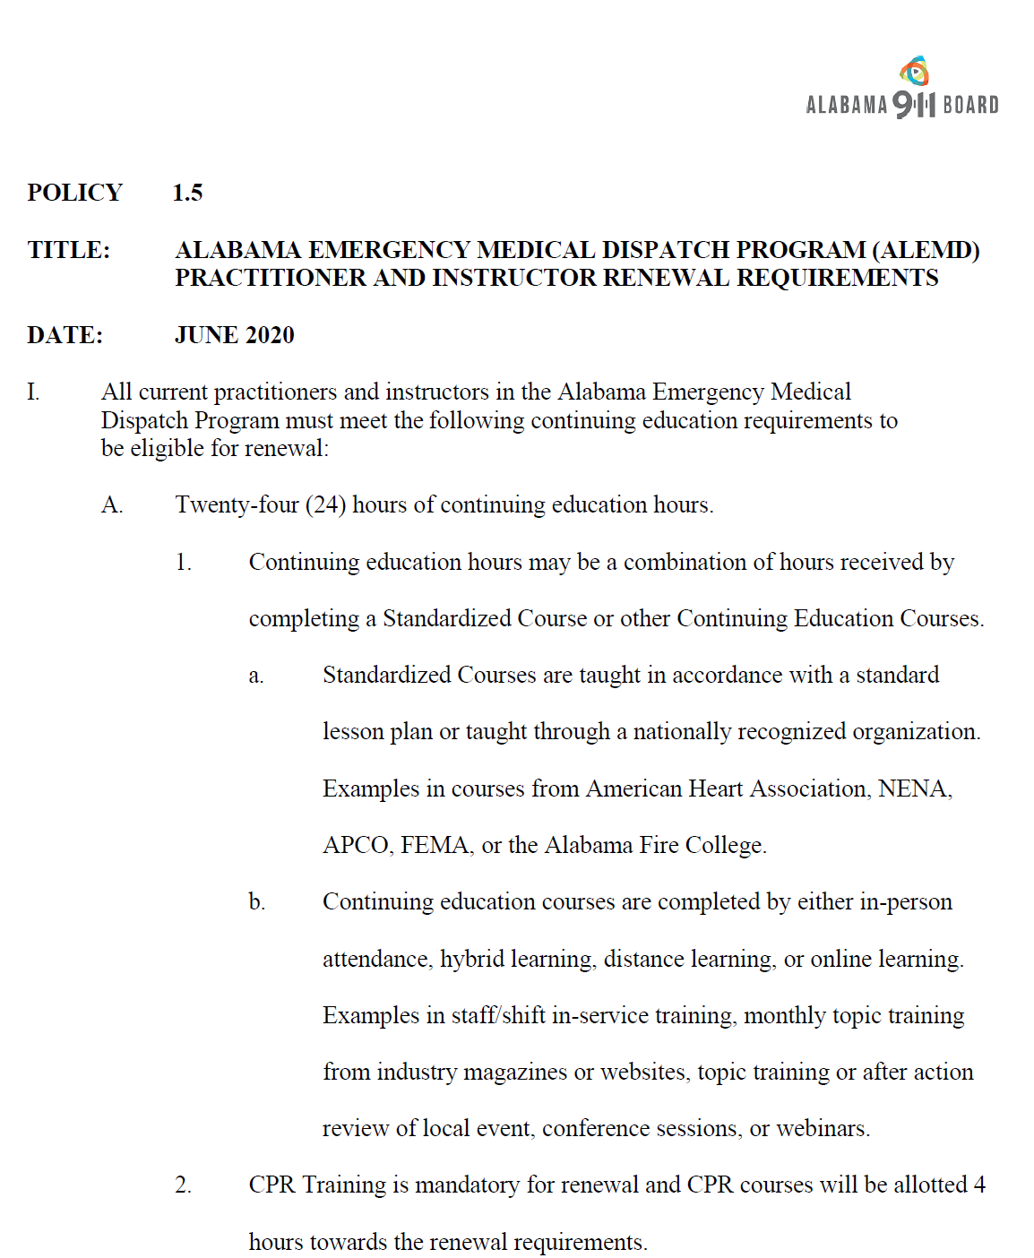
Policy
Pre-requisites for instructor
Removing/Modifying Phases
Requirements for “Master instructor”
Online registry of instructors

Slide 34
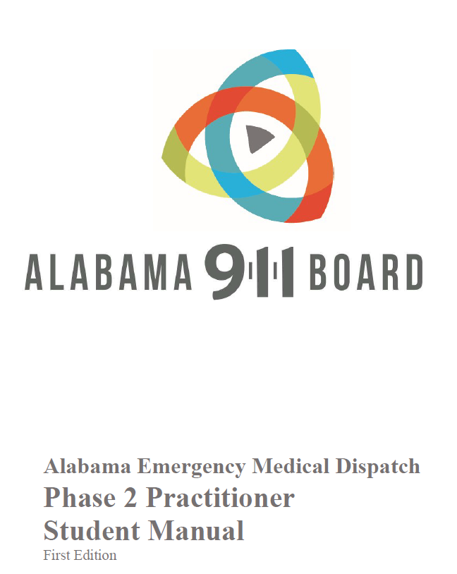
Training Material
Adding Visual Aids such as call recordings from Alabama PSAPs
Provide more complex scenarios
Potential simulation stations for skills test
More comprehensive instructor outline
Final exam to be more in depth; requiring a deeper knowledge of medical terminology
Skills evaluation (instructor)
Digital evaluations for instructors
Regular instructor meetings to collaborate
Periodic instructor evaluations

Slide 35
Contact Us
Facebook
Twitter
LinkedIn
Website
@alabama911board
@al911board
Alabama 9-1-1 Board
www.alabama911board.com

Slide 36
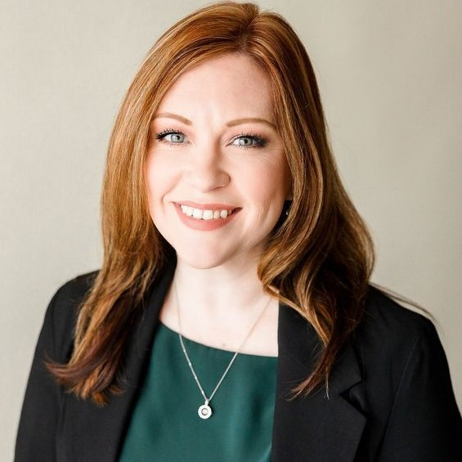
Add me to your contacts!!!

