Slide 1
How to NG911 in Alabama and Beyond! 2023 ALNENA Gulf Coast Conference

Slide 2
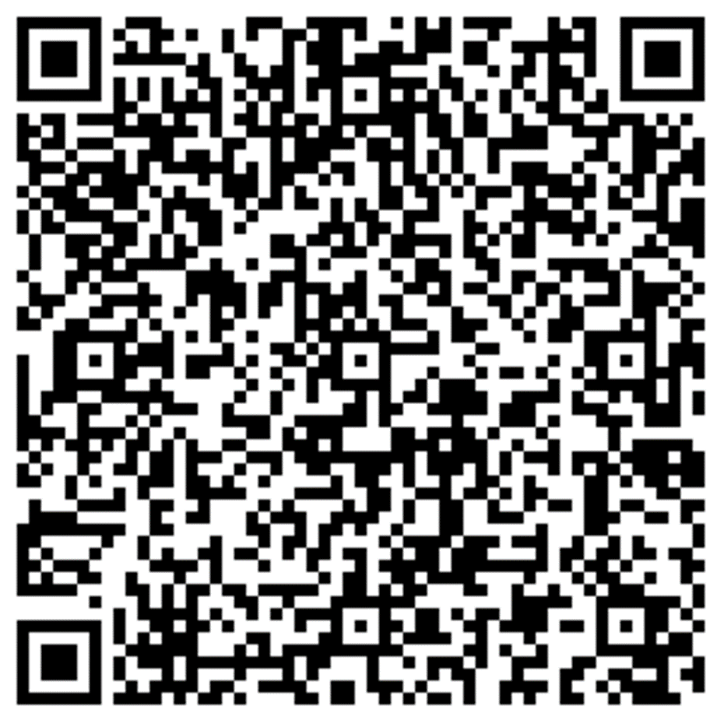
Introduction & Contact Information
Leah Missildine
Executive Director for the Alabama 9-1-1 Board
Email: leah@al911board.com
Phone: 334-440-7911
Caleb Branch
Vice President of Market Management for INdigital
Email: cbranch@indigital.net
Phone: 256-276-6854

Slide 3
Why NG911?
Fully replace Enhanced 9-1-1, with all capabilities and functions in place today
Add capabilities to support changes for current and new types of Originating Service Providers
Add flexibility for the PSAPs and 9-1-1 Authorities
Add capabilities to integrate and interoperate with emergency entities beyond the PSAP

Slide 4
Building Blocks of Alabama 911 Mission: To work in partnership with Emergency Communication Districts of Alabama to facilitate and promote effective, efficient, and reliable 9-1-1 service statewide to the residents and visitors of Alabama.
 |  |  |  |  |  |  |  | Service | Meet Expectations
 |  |  |  |  |  |  | Governance | Legislative Review | Rules and Polices
 |  |  |  |  |  | Funding | Monthly Distribution | Legacy Reimbursement | Grants
 |  |  |  |  | Security | Best Practices | Security Plans | PSAP Policies | Network Security
 |  |  |  | PSAPs | Hosted/NG CPE | CAD | Map Displays | Data Analysis | Mobile Data
 |  |  | Training | ALEMD Program | LMS Procurement | Minimum Standards | Health/ Wellness | TERT Initiative | Reclassification
 |  | GIS | Statewide Repository | PSAP Boundary | Road Centerlines | Address Points | Provisioning Boundary | Emergency Services Boundaries | Maintenance Tools
 | NGCS | ESRP | ECRF | PRF | LVF | Standards-based | Legacy Gateways | Security Functions | Discrepancy Reporting
ESInet | Redundancy | Scalability | Resiliency | Wireline Conversion | INdigital ALI | Accessibility | Texty | Language Translation | 988
Notes:
NG911 is not just ANGEN. There are many parts that build on each other and will be building on each other for a long time.

Slide 5
Lessons Learned and Considerations Using NG911

Slide 6
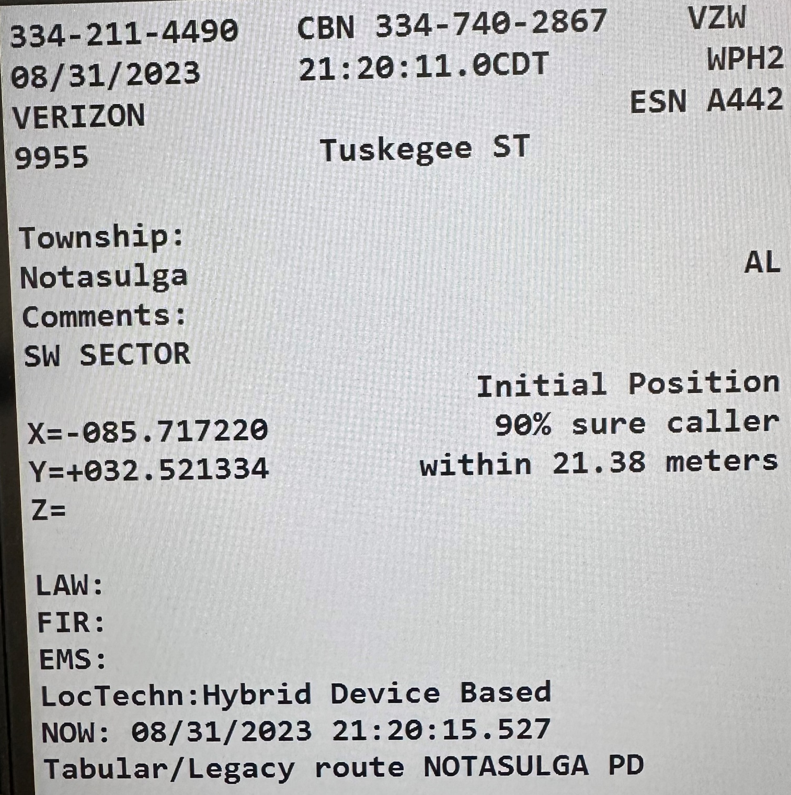
INdigital ALI Geo-Coded Addresses – WPH2
Addresses on WPH2 calls may be the tower address or an approximate location of the caller.
INdigital passes on what we receive from the Mobile Position Center – Intrado or Comtech.
Be suspicious of the addresses delivered. They are a useful tool but may not be correct due to not being validated against an authoritative data set.

Slide 7
Interim Geo-Routing
1. The call comes into the network and is held for 8 seconds.
2. The database is dipped – Intrado or Comtech.
3. The call is then routed to the appropriate PSAP based on the coordinates that are presented in the database dip.

Slide 8
End State Geo-Routing
The Call comes into the network with an attached PIDF-LO (Presence Information Data Location Object) XML document.
The PIDF-LO is cross-referenced with the Location Verification Function (LVF).
The call is routed to the correct PSAP based on the verified coordinates during the cross-reference.

Slide 9
How to Arrive at the End State Geo-Routing
Work needs to be done with the carriers and location providers to establish PIDF-LO handoff between carrier and network
A spatial interface must be established to verify location data against the state GIS set.
Call-Handling Systems must be upgraded to receive this new type of PIDF-LO-based ALI.

Slide 10
Geo-routing and Knowing When to Report Issues
Geo-routing is going to occur on only some calls. If the carrier does not provide WPH2, the call will default to Legacy/Tabular Route.
Legacy/Tabular Route on the ani/ali display is a useful indicator.
Validate GIS boundaries with what has been aggregated with Datamark VEP.
Calls that need further review: email details, ESRK, date, time to database@indigital.net

Slide 11
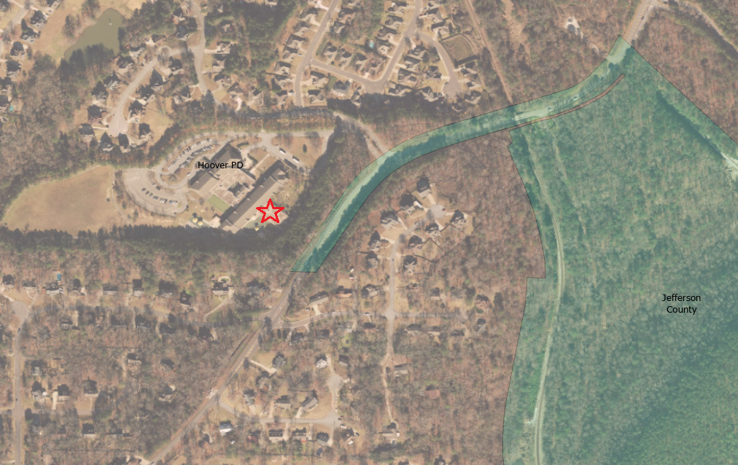

Slide 12
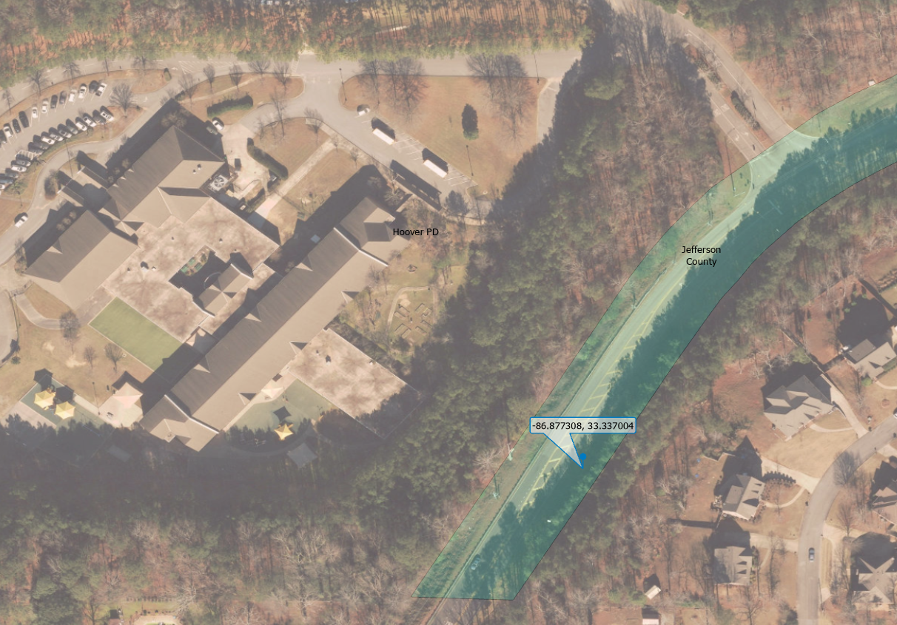

Slide 13
Considerations using NG911:
VoIP/WiFi Calls delivering to the wrong PSAP - The user, or in some cases the carrier, must manually change the 911 address in the phone or online in their user portal for the routing to change. INdigital cannot change this information. WiFi calls may also show up as WPH2.
Ability to abandon 911 calls using MEVO
How to transfer admin calls to MEVO
Transfer issues - blocking CBN

Slide 14
Considerations using NG911:
INdigital only maintains audio recordings of MEVO calls. It can be tied to a local recorder as well.
Every critical component in your PSAP should have redundancy - to include recordings of calls. IRR on Call Handling Equipment is an efficient way to review last calls but can be difficult to retrieve for retention. Recorders should be set up by Channel or Line Recording and Position Recording.

Slide 15
Considerations using NG911:
Changes to Call Handling, such as adding departments answering must be relayed to INdigital to properly parse and calculate for reporting.
When choosing or considering CHE, consult with Indigital and/or the Alabama 911 Board for best coordination for Statewide deployment.
Test MEVO or MAK regularly, including power as well as functions - go live, test.

Slide 16
Considerations using NG911:
RapidSOS Ghost Calls - accidental, NSI device, differing/bordering boundaries
Report issues for resolution - email support@indigital.net
Test MEVO
Log into Texty

Slide 17
OTM Cyber Integration into ANGEN Datacenters
Cyberbox deployment by the end of the month in Montgomery and Huntsville Datacenters.
Will provide cyber security and monitoring a proactive response.
Augments our current security monitoring.
Local company with national reach.

Slide 18
Scan the QR Code and fill out the webform for a CEU certificate.
The certificate will be emailed to the address you input.

Slide 19
Questions
Leah Missildine
Executive Director for the Alabama 9-1-1 Board
leah@al911board.com
Office: 334-440-7911

