Slide 1
ECD Roundtable 2023 ALNENA Gulf Coast Conference

Slide 2
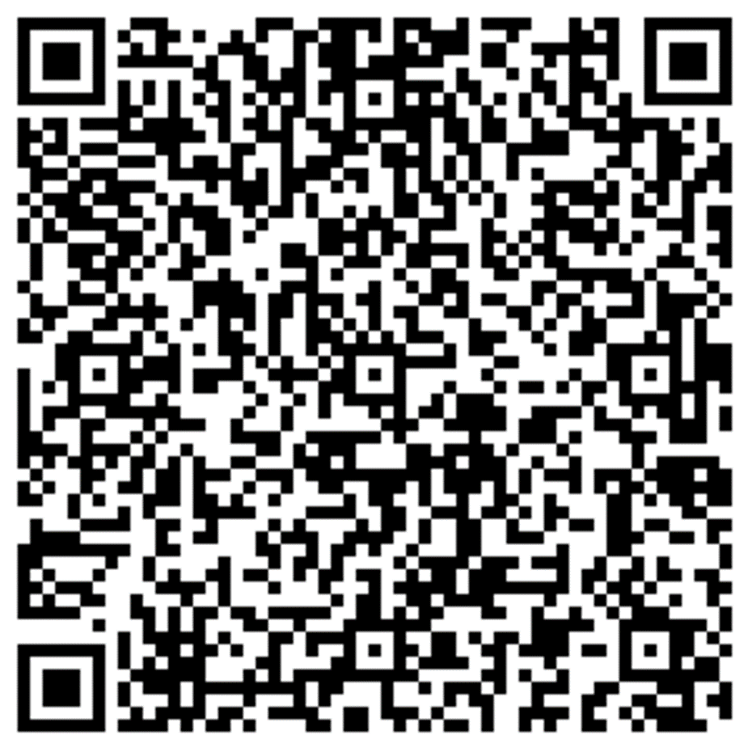
Introduction & Contact Information
Anderson Brooms
GIS Program Manager for the Alabama 9-1-1 Board
O: 334-440-7911
Email: anderson@al911board.com
Adam Brown
Deputy Director for the Alabama 9-1-1 Board
O: 334-440-7911
Email: adam@al911board.com
Laura Ehrhart
Education & Outreach Program Manager for the Alabama 9-1-1 Board
O: 334-440-7912
M: 334-451-9984
Email: laura@al911board.com
Nida Jackson
Senior GIS Specialist for the Alabama 9-1-1 Board
O: 334-440-7911
Email: nida@al911board.com
Leah Missildine
Executive Director for the Alabama 9-1-1 Board
O: 334-440-7911
Email: leah@al911board.com

Slide 3
How ECDs Operate
Differences
similarities
Non-PSAP ECDs
Administrative ECDs
ECDs that have one or more PSAPs
ECDs that are the PSAP and vice versa
ANGEN
NG911 GIS
Certification
Expectation of service level
Staffing shortages
Funding questions

Slide 4
Modernize Statutory Language
Recognize (and respect) our differences
Define what 911 surcharge should pay for
Formulate an equitable distribution formula
Determine what services your agency will offer and who will pay for what
Bolster efficiencies in more of our duties and operations

Slide 5
Contact Information
Anderson Brooms
GIS Program Manager for the Alabama 9-1-1 Board
O: 334-440-7911
Email: anderson@al911board.com
Adam Brown
Deputy Director for the Alabama 9-1-1 Board
O: 334-440-7911
Email: adam@al911board.com
Laura Ehrhart
Education & Outreach Program Manager for the Alabama 9-1-1 Board
O: 334-440-7912
M: 334-451-9984
Email: laura@al911board.com
Nida Jackson
Senior GIS Specialist for the Alabama 9-1-1 Board
O: 334-440-7911
Email: nida@al911board.com
Leah Missildine
Executive Director for the Alabama 9-1-1 Board
O: 334-440-7911
Email: leah@al911board.com

Slide 6
Questions
(334) 440-7911
Anderson Brooms
GIS Program Manager for the Alabama 9-1-1 Board
Email: anderson@al911board.com
Adam Brown
Deputy Director for the Alabama 9-1-1 Board
Email: adam@al911board.com
Laura Ehrhart
Education & Outreach Program Manager for the Alabama 9-1-1 Board
O: 334-440-7912
M: 334-451-9984
Email: laura@al911board.com
Nida Jackson
Senior GIS Specialist for the Alabama 9-1-1 Board
Email: nida@al911board.com
Leah Missildine
Executive Director for the Alabama 9-1-1 Board
Email: leah@al911board.com
Michelle Peel
Program Coordinator for the Alabama 9-1-1 Board
Email: michelle@al911board.com

